Slide 1
Chronic Disease Risk Prediction
Presented By: Group-9
Harikrishna Yarraguntla, Divya Sai Sundru, Navaneeth Gopireddy

Slide 2
Introduction
Chronic diseases are long-lasting medical conditions that persist for prolonged period, often lasting for years or a lifetime.
These conditions are usually non-contagious, controllable, but not always curable.
Examples of chronic diseases include heart disease, diabetes, cancer, and respiratory diseases, which significantly impact an individual’s quality of life and contribute to healthcare costs.
It's crucial to highlight preventive measures and early interventions to manage and reduce the impact of chronic diseases on individuals and healthcare systems.
For example, diabetes is characterized by high glucose levels in the bloodstream and influenced by genetic, lifestyle, and environmental factors. Key risk factors for diabetes development involve age, physical inactivity, poor diet, smoking, and stress, many of which can be mitigated through lifestyle changes.
Predicting the risk of diseases like diabetes can prompt lifestyle modifications, emphasizing healthy choices such as a balanced diet, regular physical activity, and weight management to reduce the risk of developing these conditions.
Primary Objective: To predict chronic disease risk based on factors like age, physical activity, diet, habits, and medical history, enabling lifestyle changes to prevent these enduring health conditions.

Slide 3
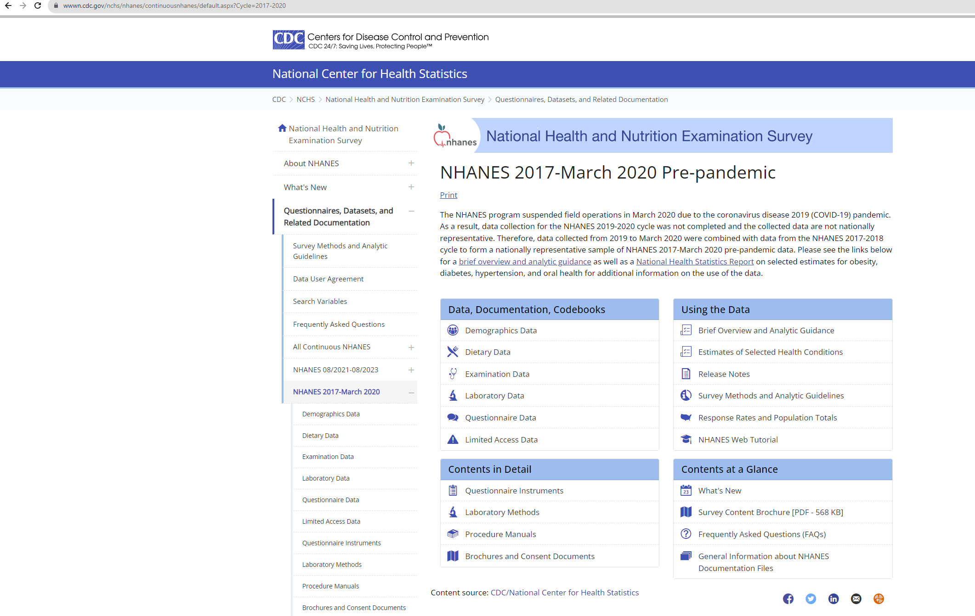
Dataset
Source: National Health and Nutrition Examination Survey – NHANES (Jan 2017 – March 2020)
The Survey supervised by National Centre for Health Statistics, evaluates the health and nutritional status of adults and children in the United States.
The survey consists of 15,560 participants
The data is available on the CDC portal, and it encompasses a wide range of factors that contribute to a understanding of health-related issues among the surveyed participants.

Slide 4
Dataset Description
The survey data for the 15,560 participants is split into five categories:
Category | Description
Demographics | Includes details such as gender, age, race, education, marital status, country of birth etc.
Dietary | Encompasses data on food consumption, nutrient intake and vitamin levels
Examination | Consists of information on health metrics like blood pressure and cholesterol
Laboratory | Information on chemical components in body from medical examinations
Questionnaire | Responses of interview questions to the participants and it serves as critical component

Slide 5
Research Questions
What are the optimal methods for effectively cleaning and preparing extensive data for modeling?
Can lifestyle features of a person can be used to predict the risk of chronic disease?
Which factors in our daily lives significantly contribute to the development of chronic diseases?
How can we improve feature selection to capture crucial details for predicting the risk of chronic diseases, including lifestyle features, medical history, and social factors?
Which machine learning models, such as Logistic Regression, Decision Tree, Support Vector Machine, or K-Neighbors Classifier, are most effective in classifying the risk of specific chronic diseases with maximum accuracy and minimal overfitting?
Is it feasible to develop a user-friendly dashboard for convenient accessibility to this information?

Slide 6
Methodology
Data Processing and Cleaning
Data Visualization
Model Pre-Processing
Initial Model Building
Forward Selection
Hyperparameter Tuning
Model Results Evaluation
Dashboard Development

Slide 7
Data Processing and Cleaning
Data Acquisition: Commenced by gathering extensive NHANES 2017-2020 survey data, covering demographics, dietary habits, examination results, laboratory findings, and questionnaire responses.
Complex Dataset: The dataset comprised numerous intricate and detailed variables, posing initial challenges in effectively managing and understanding the data for the project's objectives.
Data Cleaning and Filtering: Devoted considerable time to meticulously clean and filter the exhaustive NHANES datasets. Evaluated variables' relevance for chronic disease risk prediction, discarding less impactful ones (e.g., Education Level - 'DMDEDUC2' from demographics).
Predictor Variable Extraction: Extracted key categorical target variables from questionnaire data, serving as predictors for seven chronic diseases. Synthesized these into a unified chronic disease prediction variable, streamlining health risk assessment.
Data Integration: Integrated diverse datasets into a comprehensive data cube, crucial for combining various health-related factors for unified analysis.
Variable Transformation: Renamed columns for readability (e.g., RIAGENDR to Gender category). Recoded binary and multicategory variables to ensure consistency in analysis.
Cleaning Missing Values: After integrating datasets, addressed missing values by removing records with non-overlapping data. This reduction, from 15,560 to 7,086 records, ensured data stability and completeness for accurate chronic disease risk prediction models. Further refinement led to a condensed dataset of 5,314 records by eliminating individuals with multiple diseases and kidney failure instances due to their notably fewer occurrences compared to other disease categories.
The final dataset from Data Processing and Cleaning constituted of 5,314 records and 44 features.

Slide 8
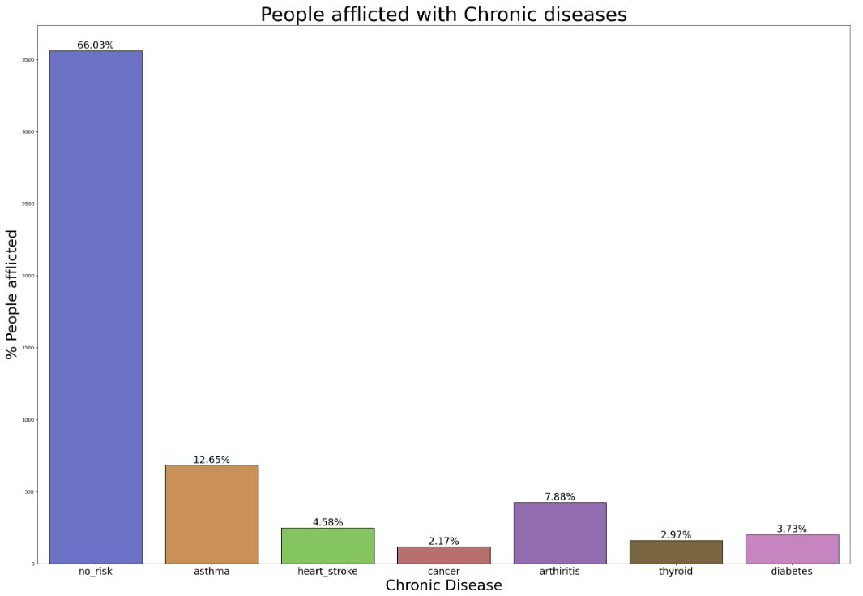
Data Visualization
The resulting 5,314 records are split into following classes:

Slide 9
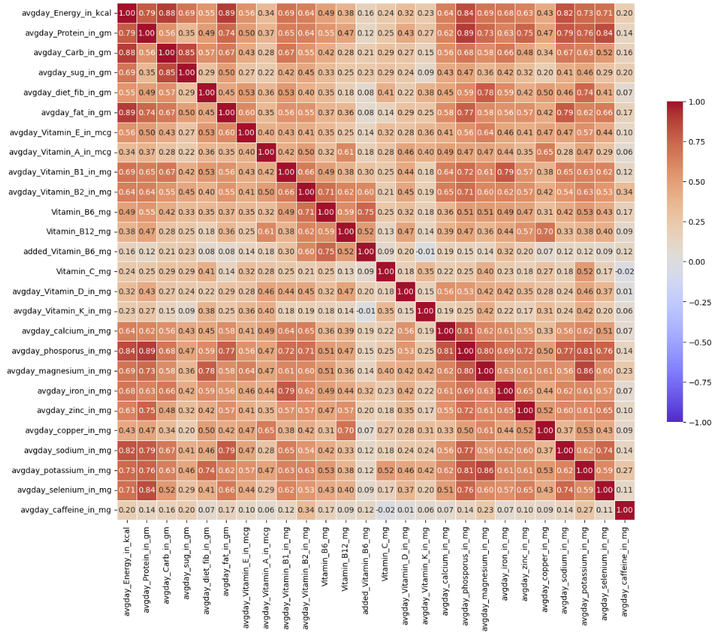
Data Visualization
Feature Elimination using correlation analysis:
The figure suggests a strong correlation between chemical body components and food intake, which is expected.
Consequently, to address the high multicollinearity, the chemical component variables were eliminated from the dataset.
This reduced the features from 44 to 32

Slide 10
Model Pre-processing
Data Splitting: The data is split into train and test sets with 80% and 20% of the data, respectively. The training set is used to train the model, while the testing set evaluates the model's performance on unseen data
One-Hot Encoding: Transforming categorical variables into a binary format to allow for better interpretation by the model. For instance, converting gender categories (male/female) into binary representations (0/1).
Standard Scaling: Normalizing numerical features to a standard scale, usually mean of 0 and standard deviation of 1. This ensures that all features contribute equally to the model and prevents certain features from dominating due to larger scales. This also improves the modelling efficiency to run the models in shorter time

Slide 11
Initial Model Building
Initial models are run using the training dataset and performance metrics are evaluated using test dataset
Model | Model Accuracy | Model Recall | Model F1 Score
Logistcic Regression | 66% | 66% | 56%
Decision Tree Classifier | 49% | 49% | 51%
Random Forest Classifier | 67% | 67% | 54%
Kneighbors Classifier | 60% | 60% | 54%
Suppot Vector Machine | 66% | 66% | 53%
Neural Networks | 66% | - | -

Slide 12
Forward Selection
Forward selection is employed to build predictive models by sequentially adding the variables. Starting with an empty model, we iteratively include variables that best predict chronic disease risks based on their significance. Finally, we would arrive at feature set which has less complexity.
Model | Features Eliminated | Model Accuracy | Model Recall | Model F1 Score
Logistcic Regression | 18 | 66% | 66% | 52%
Decision Tree Classifier | 18 | 51% | 51% | 51%
Random Forest Classifier | 18 | 66% | 66% | 55%
KNeighborsClassifier | 18 | 60% | 60% | 55%
Suppot Vector Machine | 18 | 66% | 66% | 53%
We eliminated around 18 distinguish features for each model reducing the complexity, but it was not really helping in boosting the accuracy of the model

Slide 13
Hyper Parameter Tuning
Optimized parameters for each model are determined using Grid Search. It optimizes models by testing various hyper parameter combinations, based on accuracy final parameters would be determined
Model | Parameters Tuned | Model Accuracy | Model Recall | Model F1 Score
Logistic Regression | C: 0.1, penalty: l2, solver: liblinear | 67% | 67% | 55%
Decision Tree Classifier | criterion: gini, max_depth: 5, max_features: log2, min_samples_leaf: 1, min_samples_split: 2, splitter: random | 66% | 66% | 53%
Random Forest Classifier | bootstrap: True, criterion: gini, max_features: sqrt, n_estimators: 300 | 66% | 66% | 53%
KNeighborsClassifier | algorithm: auto, leaf_size: 20, n_neighbors: 9, p: 2, weights: distance | 64% | 64% | 54%
Suppot Vector Machine | C:1, decision_function_shape: ovo, degree: 2, gamma: scale, kernel: rbf | 66% | 66% | 53%

Slide 14
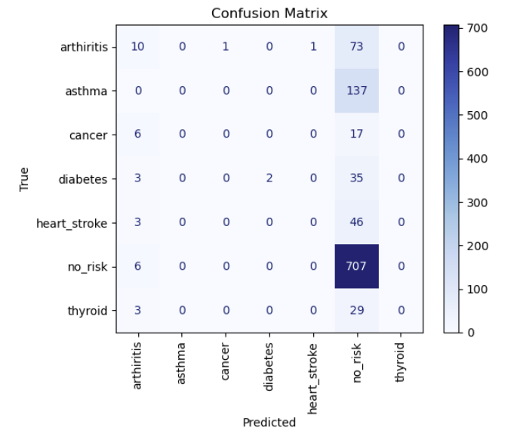
Model result Evaluation
Final Model: Based on the mode results, Logistic Regression model with parameters C: 0.1, penalty: l2, solver: ‘liblinear’ is being selected as the final model, as it has the better accuracy of 67% among all other models and is simple.

Slide 15
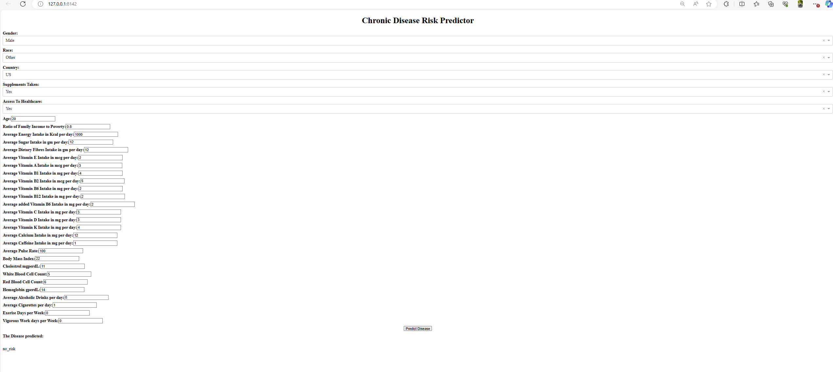
Dashboard Development
A dashboard is being developed using Dash, utilizing the features from the finalized model. This dashboard takes user-inputted features, employs the model to predict the disease outcome, and displays the resulting output.

Slide 16
Limitations
Reduced Dataset Size Impacting Accuracy: Despite continuous efforts in data cleaning and processing, the real-world complexities resulted in a substantial reduction of available data for analysis. From an initial pool of 15,560 records, our dataset dropped to 5,314 valid records. This significant reduction has adversely affected the model's accuracy levels.
Imbalanced and Diluted Dataset: The distribution of the 5,314 records across eight disease classes resulted in an imbalance, with a limited number of records allocated to each class. This imbalance has led to a diluted model, significantly impacting accuracies across all classes, which consistently fall below 70%.

Slide 17
Conclusion
Explored extensive data cleaning, filtering, and integration techniques for a unified analysis framework.
Utilized lifestyle features to predict specific chronic diseases using a classification model..
Assessed Logistic Regression, Decision Tree , Random Forest, Support Vector Machine, and K-Neighbors Classifier for classifying disease risks, aiming for accuracy while managing data limitations.
Created a user-friendly dashboard integrating input features for predicting disease outcomes.

